Slide 1
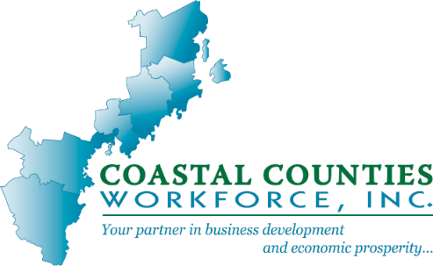
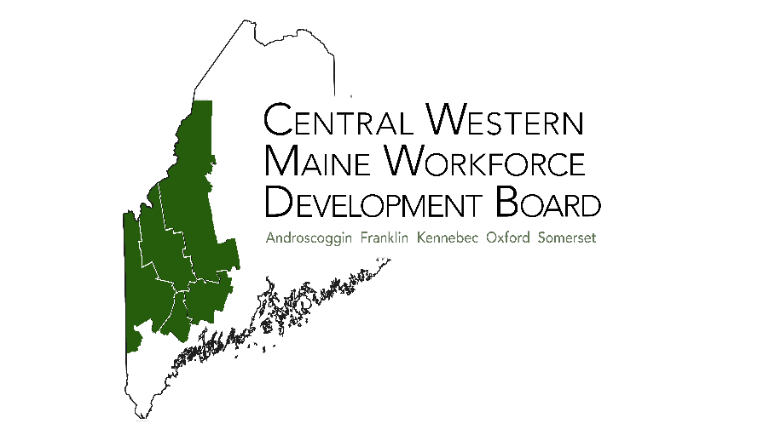
Workforce Boards & Adult Education: How Do They Work Together
Nourish to Flourish
MAEA Conference June 21, 2023

Slide 2
Overview of Workforce System
What is Workforce Development?
Workforce Development involves activities and services designed to increase individuals’ employment and earning potential.
Job search, placement assistance, career counseling, training, and other job preparation activities
Workforce development is also referred to as “workforce investment” or “employment services.”

Slide 3
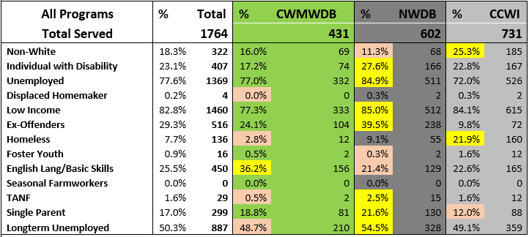
PY21 Maine WIOA Service Persons w/ Barriers to Employment

Slide 4
Workforce Development: A Historical Review
Employment Service (1933 Wagner-Peyser Act)
MDTA (1962 Manpower Development Training Act)
CETA (1973 Comprehensive Employment and Training Act)
JTPA (1982 Job Training Partnership Act)
WIA (1998 Workforce Investment Act)
WIOA (2014 Workforce Innovation & Opportunity Act)

Slide 5
Workforce Development Nationwide
More than 560 Local Workforce Development Boards (LWBs) nationwide are responsible for overseeing the implementation of America’s public workforce investment system in their local communities.
There is a nationwide system of public and private agencies working in partnership with local communities and businesses.
The 2014 Workforce Innovation & Opportunity Act (WIOA) mandated that partners involved in workforce development integrate services in order to improve the skills of America’s workforce, reduce welfare dependency, and enhance the nation’s productivity and competitiveness.
This requires collaboration among the numerous federal, state, and local agencies, non-profit organizations, employers, and workers.

Slide 6
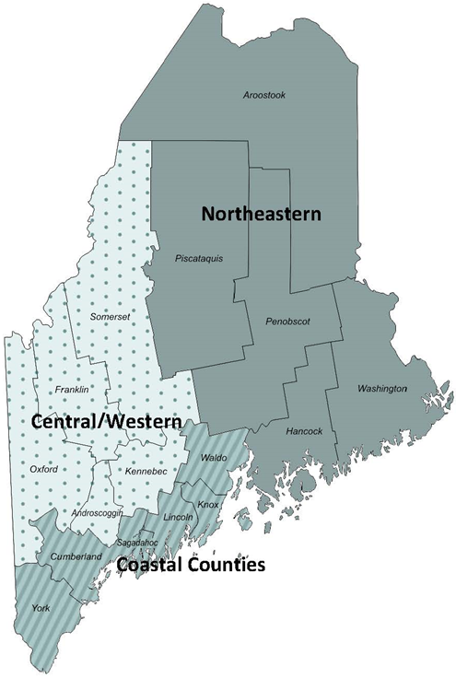
A Regional Workforce System
Northeastern Region Serving Aroostook, Piscataquis, Penobscot, Hancock, and Washington Counties Galan Williamson, Executive Director www.northeasternWDB.org
Central / Western Region Serving Androscoggin, Franklin, Kennebec, Oxford, and Somerset Counties Erin Benson, Executive Director www.cwmwdb.org
Coastal Counties Region Serving Waldo, Knox, Lincoln, Sagadahoc, Cumberland, and York Counties Antoinette Mancusi, Executive Director www.coastalcounties.org

Slide 7
What is a Workforce Board?
Employment & Training Administration:
The regional workforce system, in alignment with the state workforce system, engages and convenes all core and mandatory one-stop partners and supports the development and implementation of local one-stop policies and processes, service delivery design, infrastructure, and certification criteria.
National Association of Workforce Boards:
Identify needs of local job market
Oversee One Stop Career Centers
Work to create & align workforce development initiatives in CWM
Foster high growth career opportunities to meet the needs of the regional economy
Target recruitment opportunities
Identify labor market trends
Partner on economic development investments
Create resources to benefit all members of the community

Slide 8
WIOA Core Partners
Four Core Partners:
Title 1 Adult, Dislocated Worker & Youth Programs MDOL
Title 2 Adult Education & Family Literacy MDOE
Title 3 Bureau of Employment Services (Career Centers) MDOL
Employment Services
Trade Adjustment Assistance
Unemployment Insurance
Jobs for Veterans
Title 4 Bureau of Rehabilitation Services (Vocational Rehab) MDOL

Slide 9
WIOA Required Partners
Maine Community Colleges, Postsecondary Carl B. Perkins Act Grant recipients;
Maine Department of Health and Human Services, Community Services Block Grant;
Maine Department of Health and Human Services, Temporary Assistance for Needy Families / Additional Support for People in Retraining and Employment (TANF/ASPIRE);
Associates for Training and Development (A4TD), Senior Community Services Employment programs;
Pathstone, National Farmworker Jobs program;
Housing and Urban Development, Employment and Training Programs;
Career Systems Development for Loring and Penobscot Job Corps programs;
Penobscot Indian Nation, Native American program grant;
Youth Build Programs

Slide 10
Support for Job Seekers
Career counseling and planning
Identify career pathways
Job placement and development
Diploma/HiSET completion
Attain post-secondary credentials
Link to work-based learning opportunities
Increase earning potential
Financial Literacy
Tuition assistance
Training supplies
Textbooks, tools, safety equipment, etc.
Transportation
Childcare
Clothing (Interview attire, required work uniforms)
Emergency Services (Automobile repairs)

Slide 11
Integrated & Coordinated WIOA Services
The Workforce Innovation and Opportunity Act (WIOA) calls for an integrated and coordinated service delivery system that leverages and maximizes resources in a way that reduces unnecessary duplication of services.

Slide 12
WIOA 1B & Adult Ed
A Marriage Made in Heaven
Projects
Employer need (Business)
Training (Adult Ed)
Job Seeker support (WIOA 1B)
Communication
Partnership
Timeliness

Slide 13
Questions?

